Slide 1
Presentation of the HIV/AIDS Language Compendium
Juliette McHardy, HIV Policy Lab, Global Health Policy and Politics Initiative, O’Neill Institute for National and Global Health Law, Georgetown University
Protecting and expanding political commitments on rights-based responses to HIV-AIDS in the UN System
I have no relevant financial relationships with ineligible companies to disclose.

Slide 2
Background to the Compendium
The Compendium results from a preliminary document prepared as an aid to those involved in negotiations at the 2021 high-level meeting.
It was a response to those who seek to delegitimise, weaken and excise remove lan­guage on rights, decrim­i­nal­i­sa­tion and harm reduc­tion in our international agreements.
In its exten­sion at the ini­tia­tive of GNP+ and Aids­fonds, the NGO co-con­ven­ers for the HLM, we have sought to create a more comprehensive but similarly simple and easy to use tool.
What the Compendium is: A curated com­pi­la­tion of inter­na­tion­ally agreed upon lan­guage that pro­vides prece­dents for the use, proper inter­pre­ta­tion and sig­nif­i­cance of con­cepts and terms cru­cial for an evi­dence-based and rights-affirm­ing response to HIV
Notes:
Depart­ing from prece­dents and set­tled posi­tions of pre­vi­ous high-level meetings and other meet­ings of the Gen­eral Assem­bly, in 2021 a small group of coun­tries sought to remove lan­guage on rights, decrim­i­nal­i­sa­tion and harm reduc­tion from the draft Polit­i­cal Dec­la­ra­tion.
The HIV Pol­icy Lab devel­oped the pro­to­type of this Com­pendium dur­ing the 2021 HLM. It is now extended at the initiative of GNP+ and Aidsfonds under the aegis of the Love Alliance.

Slide 3
Lan­guage choices in inter­na­tional com­mit­ments are contested because they both reflect and deter­mine whose lives mat­ter, whose health will be pri­ori­tised, and whose rights must be respected.
The language of UN Resolution, Decisions, and Political Declarations informs and shapes political decisions, funding commitments and targets at both global- and country-level.
Notes:
The underlying premise of the Compendium is that lan­guage choices in inter­na­tional com­mit­ments are a life-or-death mat­ter for mil­lions of peo­ple. They both reflect and deter­mine whose lives mat­ters, whose health will be pri­ori­tised, and whose rights must be respected.

Slide 4
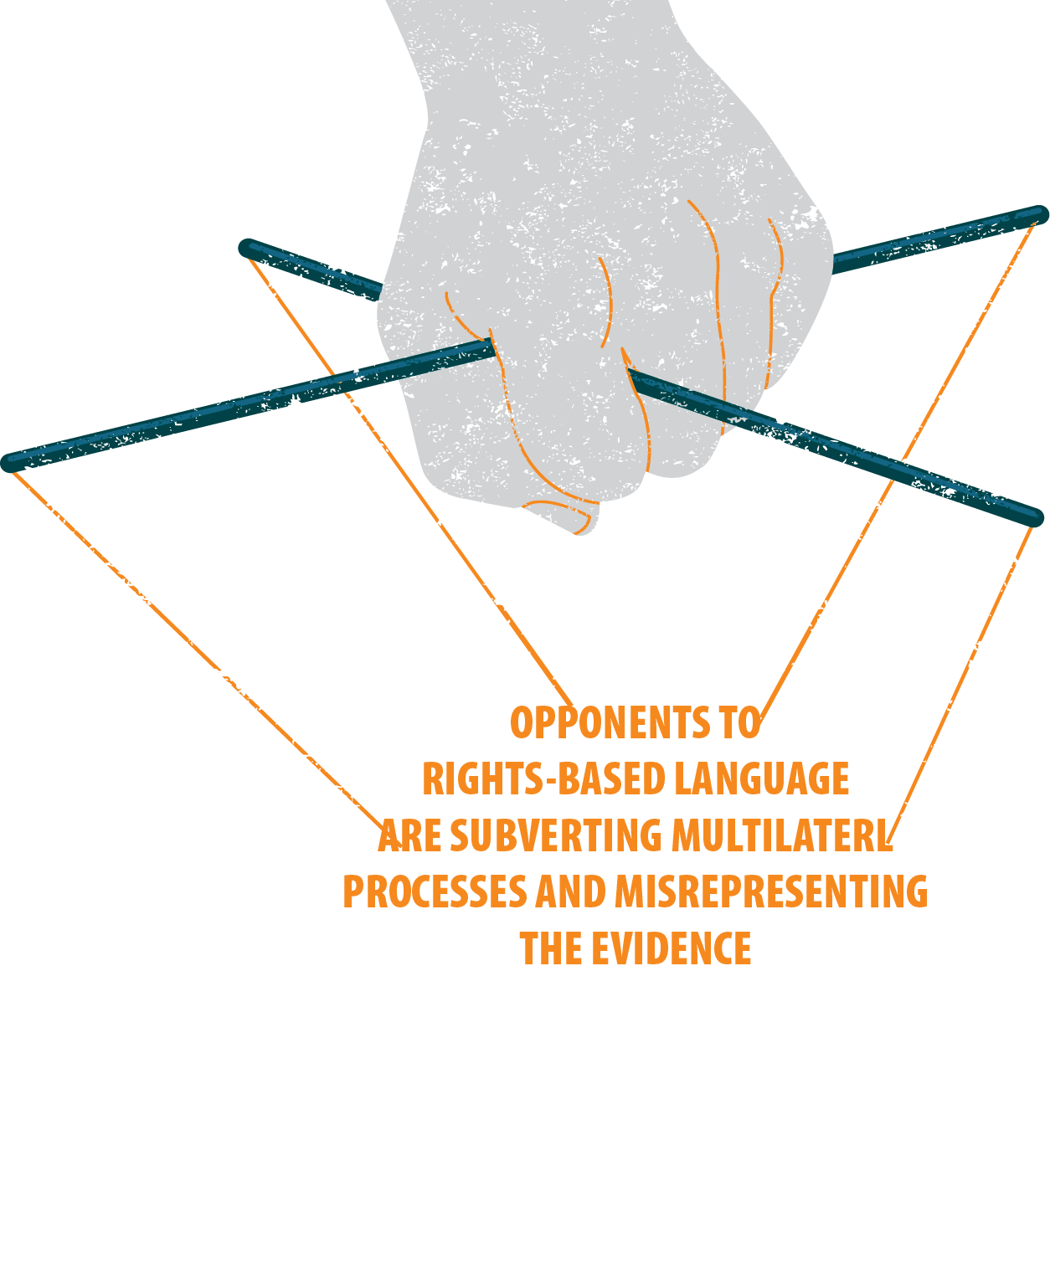
"Conservative opposition to a rights-based approach to HIV is mounting, and it begins with challenges to how the world speaks about rights in the context of HIV," - Love Alliance PARTNER
Notes:
This space for human rights, health and, in par­tic­u­lar, sex­ual and repro­duc­tive health rights needs to be pre­served against encroach­ment from alter­na­tive lan­guage rooted in notions of patri­archy, het­ero­nor­ma­tiv­ity, cis­nor­ma­tiv­ity, racism and ableism.

Slide 5
Lan­guage mat­ters to the oppo­nents of human rights. It needs to mat­ter as much, if not more, to the pro­po­nents and defend­ers of human rights.
Progress on cen­ter­ing human rights in health has been won, in part, through shifts in lan­guage—to pre­vent rever­sals, we need to iden­tify, delimit and defend key lan­guage for the HIV response as well as related sex­ual and repro­duc­tive health chal­lenges
Notes:
The premise of the Compendium is that lan­guage mat­ters to the oppo­nents of human rights and it needs to mat­ter as much, if not more, to the pro­po­nents and defend­ers of human rights. Hold­ing and advanc­ing the line for rights-affirm­ing and evi­dence-based responses to HIV and related sex­ual and repro­duc­tive health chal­lenges despite this oppo­si­tion requires we know the key lan­guage used in inter­na­tional agree­ment as well as its inter­na­tion­ally agreed upon mean­ing and sig­nif­i­cance.

Slide 6
For example, in the case of international commitments for the HIV response, defending rights based language entails preserving space and priority for clearly defined key populations
Opponents to human rights have sought to reduce the usefulness of language around “key populations” by making it subject to arbitrarily determined national definitions instead of generally applicable and evidence-based definitions that encompasses people living with HIV, sex workers, people who use and inject drugs, men who have sex with men, transgender people and other LGBT people
Notes:
This can be seen for language on key and vulnerable populations which is a prominent and important example of the urgent need that animates the Compendium. Opponents to human rights have sought to both entirely displace and, in the alternative, to reduce the usefulness of language around “key populations” by making it subject to arbitrarily determined national definition.

Slide 7
“the impor­tance of agreed lan­guage should not be under­es­ti­mated. ... Lan­guage on sex­ual and repro­duc­tive rights and vul­ner­a­ble pop­u­la­tions at high risk of HIV infec­tion has been adopted, for exam­ple in the UN Gen­eral Assem­bly res­o­lu­tions on HIV/AIDS and can be used as a prece­dent to sup­port such lan­guage in other res­o­lu­tions in other orga­ni­za­tions...”
The Geneva Grad­u­ate Insti­tute’s Global Health Cen­tre
Notes:
Knowing past precedents helps combat this. Precedent supports the inclusion of similar language in future agreements and resolutions from the same or other organisations

Slide 8
How the Compendium will help
By substantiating key language it (1) pro­vides a bul­wark against efforts to reverse the tide of progress by weak­en­ing lan­guage in future ­nego­ti­a­tions and (2) sup­port efforts to trans­late related com­mit­ments into norms within national law and pol­icy.
The Com­pendium substan­ti­ates key lan­guage with prece­dents of prior use in exist­ing inter­na­tional agree­ments and the human rights system. It also contextualises these terms with authoritative evidence.
Notes:
We have first of all sought to define key terms which has been and is sub­ject to con­tes­ta­tion in the nego­ti­a­tion, inter­pre­ta­tion and imple­men­ta­tion of inter­na­tional agree­ments.
We have then identified key documents produced by high-level UN governance bodies and by other intergovernmental meetings then contextualised this with reference to elaborations on obligations provided by the human rights system and evidence produced by UN secretariats
We then draw our precedents and evidence that substantiates our key terms.

Slide 9
"The fight for human rights within the HIV response doesn’t end on paper — but it starts there.” – GNP+, A Love Alliance Member
Notes:
In this way, we hope the Compendium will assist us in at least ensuring that decades of progress on human rights is not stripped from the lexicon of the HIV response.

Slide 10
Who the Compendium will be used by
This Com­pendium is for all those seek­ing to advance and pro­tect rights-affirm­ing and evi­dence-based responses to the HIV epi­demic and related sex­ual and repro­duc­tive health chal­lenges.
It is specifically designed to help as:
A resource for those con­cerned with and involved in mul­ti­lat­eral nego­ti­a­tions including diplo­mats, other gov­ern­ment offi­cials and inter­na­tional civil ser­vants as well as civil soci­ety actors such as mem­bers of affected com­mu­ni­ties, advo­cates and aca­d­e­mics.
A resource for those seek­ing to advance or advo­cate for the align­ment of national laws, poli­cies and prac­tices with rel­e­vant global com­mit­ment including par­lia­men­tar­i­ans, gov­ern­ment offi­cials, affected com­mu­nity mem­bers, civil soci­ety advo­cates and aca­d­e­mics.
Notes:
The Compendium is is a highly prac­ti­cal resource and because of this we have sought to design it with our intended readers in mind.
It is specifically designed to help those in the cen­tre and on the side­lines of mul­ti­lat­eral nego­ti­a­tions includ­ing diplo­mats, inter­na­tional civil ser­vants, lead­ers from affected com­mu­ni­ties, and civil soci­ety advo­cates
At the same time, we can see it being useful for those involved in national implementation, advocacy and policymaking.

Slide 11
This is only a first step
The Compendium is a living document that we are committed to expanding, improving and updating as well as disseminating and seeing used
Notes:
This Com­pendium will be extended iter­a­tively to encom­pass more key lan­guage, evi­dence, and oppo­si­tion lan­guage.
If you have com­ments on its struc­ture or sug­ges­tions for the con­tent of the next edi­tion of the Com­pendium, please reach out to us.
What we are launching today is only a first step and we hope to have your help in making sure those steps that follow lead us in the right direction.

Slide 12
hivlanguagecompendium.org
Now see for yourself at
Produced by
Notes:
Please do visit and read the Compendium.

